Slide 1
Disk Space Management Tool
This tool helps users manage their disk space efficiently. It analyzes disk usage, provides recommendations, and automates cleanup tasks.
Presented by:
Priyanka A
S Gayathri
Yamini D
Anusree M
S Chinni Naga Renuka

Slide 2
Overview
1 Disk space analysis
2 Automated Cleanup
The tool provides comprehensive insights into disk space usage, breaking down data by file types, folders, and applications.
The tool automates disk cleanup tasks, freeing up space and improving system performance.
3 Customization & Alerts
Users can customize the tool's settings and receive alerts when disk space is low or when specific thresholds are reached.

Slide 3
PROBLEM STATMENT
Disk Space Management Tool
POC: • CRUD: Disk usage data.
• analyze_disk_space(analysis_id): Analyze and report on disk space usage across servers. • suggest_cleanup_actions(action_details): Suggest actions to free up disk space.
Code: To meet your request for designing a Python-based solution for a Disk Space Management Tool proof of concept (POC), I will include the following components:
Class definitions for handling disk usage data and operations.
Methods for disk space analysis and cleanup suggestions.
Basic data handling using built-in types.
Modularity, documentation, and unit testing.

Slide 4
Key Features
Disk Usage Analysis
Disk Cleanup
The tool offers detailed reports on disk space usage, breaking down data by file size, date modified, and file type. It provides clear visualizations and charts to help users understand their data and identify potential space-consuming files.
The tool offers several cleanup options, including deleting temporary files, removing duplicate files, and clearing browser cache. Users can choose from pre-defined cleanup options or customize their own cleaning tasks.
Alerts & Notifications
The tool sends alerts and notifications to users when disk space is low or when specific thresholds are reached. Users can customize the frequency and types of notifications they receive.

Slide 5
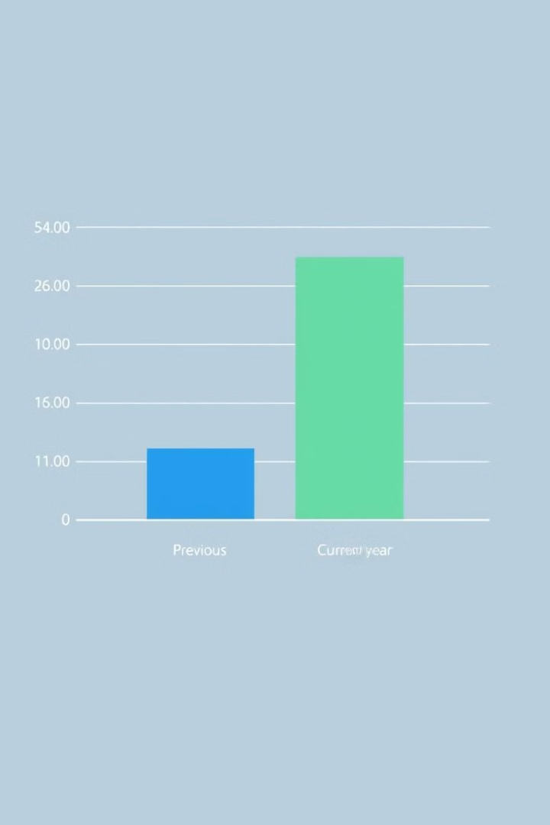
Disk Usage Data
File Type
Size
Percentage
Documents
40%
20GB
Images
15GB
30%
Videos
10GB
20%
Other
5GB
10%

Slide 6
Analyze and Report on Disk space usage
1
Data Collection
The tool continuously monitors disk space usage and collects data on file sizes, file types, and timestamps.
2
Data Analysis
The tool analyzes the collected data and identifies patterns, trends, and anomalies in disk space usage.
3
Report Generation
The tool generates reports summarizing disk space usage, highlighting potential issues and providing actionable insights.

Slide 7



Automatic Cleanup Recommendations
Delete Temporary Files
The tool automatically identifies and recommends deleting temporary files that are no longer needed, freeing up valuable disk space.
Remove Duplicate Files
The tool identifies and recommends deleting duplicate files, which can take up significant disk space, especially with large media libraries or document collections.
Optimize Folder Structure
The tool analyzes folder structure and suggests ways to organize files more efficiently, potentially reducing the overall size of folders and freeing up space.

Slide 8
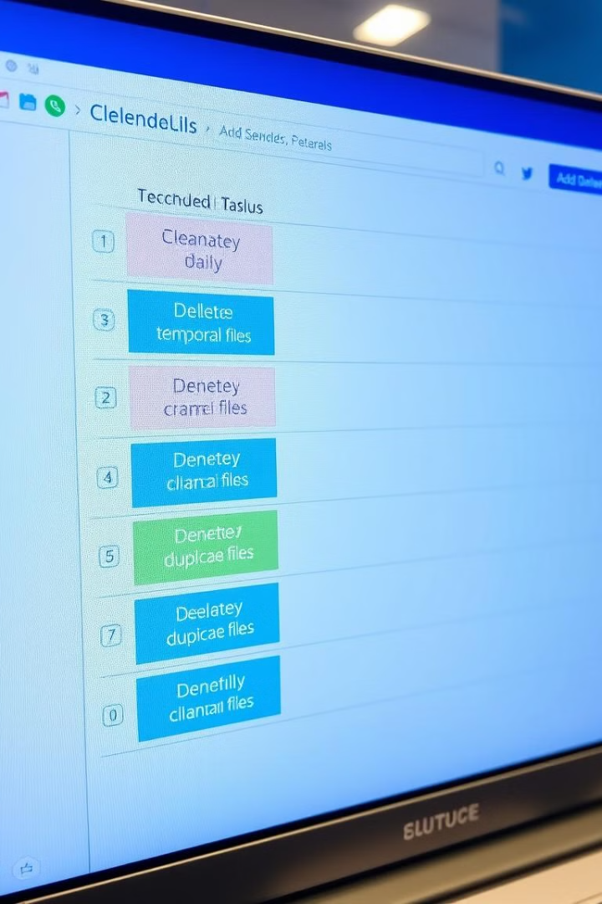



Scheduled Cleanup Tasks
Schedule Definition
Users can define schedules for automated cleanup tasks, specifying the frequency and types of cleanup to be performed.
Task Execution
The tool automatically executes the scheduled cleanup tasks at the specified intervals, ensuring regular maintenance and freeing up disk space.
Log & Reporting
The tool keeps a log of completed cleanup tasks, providing users with detailed information about the files deleted and the space reclaimed.

Slide 9
Customizable Alerts
Disk Space Thresholds
Alert Types
Users can customize the disk space thresholds that trigger alerts. They can set specific percentages or absolute values for disk space remaining that will trigger notifications.
Users can choose from different types of alerts, such as email notifications, desktop pop-ups, or even text messages. The tool offers flexibility in how users receive alerts.
Customization Options
Users can customize the content and frequency of alerts. They can tailor the alerts to fit their specific needs and preferences, ensuring they receive timely and relevant notifications.

Slide 10

Conclusion
By analyzing disk space usage, automating cleanup tasks, and providing customizable alerts, the Disk Space Management Tool helps users maintain their digital spaces efficiently. It allows users to gain valuable insights into their data, reclaim valuable disk space, and improve the overall performance of their devices.
Conclusion

